Slide 1
Convolutional neural networks example
Brian Caffo

Slide 2
In this class we’ll go over a (silly) example of CNNs
In this class we’ll go over a silly example of a CNN using cryptopunks
Cryptopunks are a set of 10,000 png files that are bought and sold on a blockchain (ethereum)
I used this example since it was a current event at the time (the ceiling price for buying a cryptopunk was in the millions!)
But, it still works as an example relevant for working with images that is both simple and different than the normal examples

Slide 3
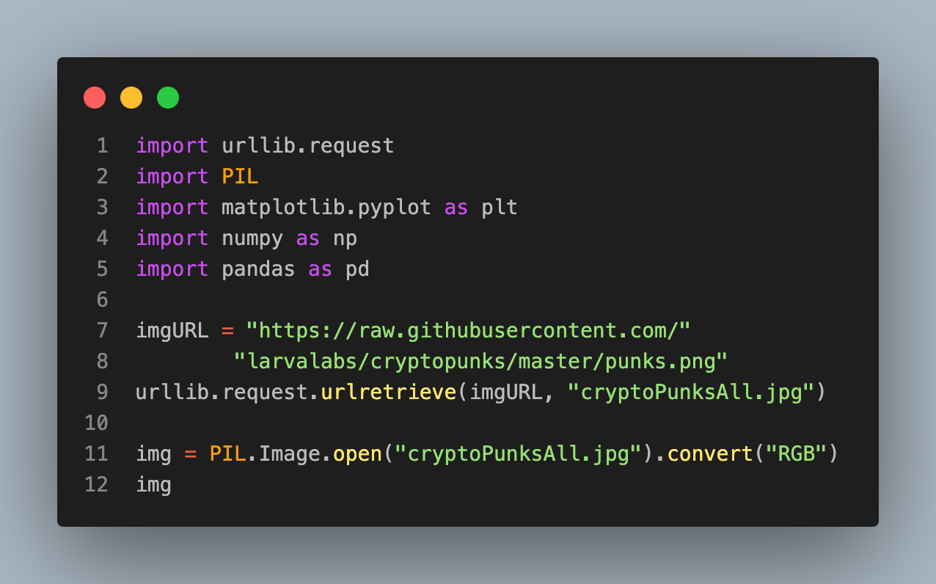
Imports and download the data

Slide 4


Slide 5
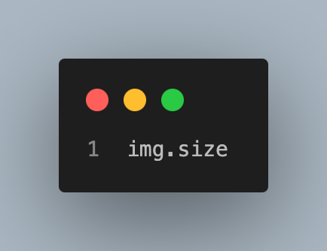
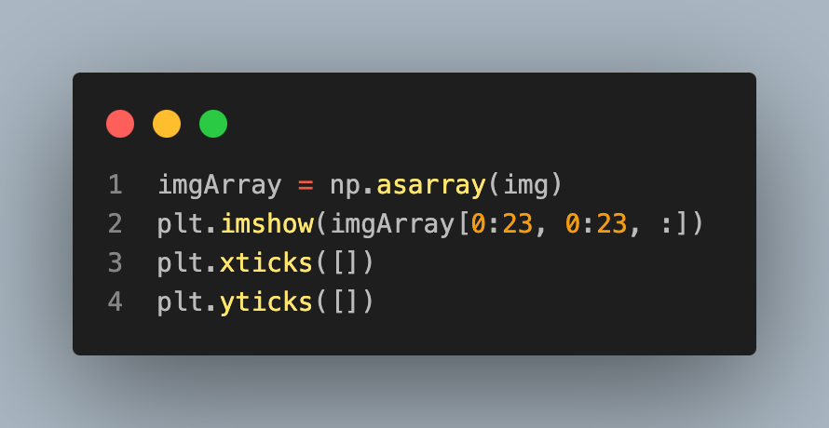
Checking
(2400, 2400)

Slide 6

Punk #0

Slide 7
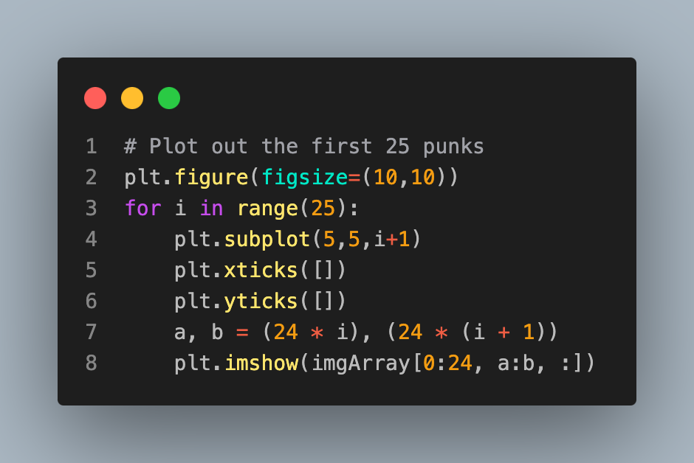


Slide 8
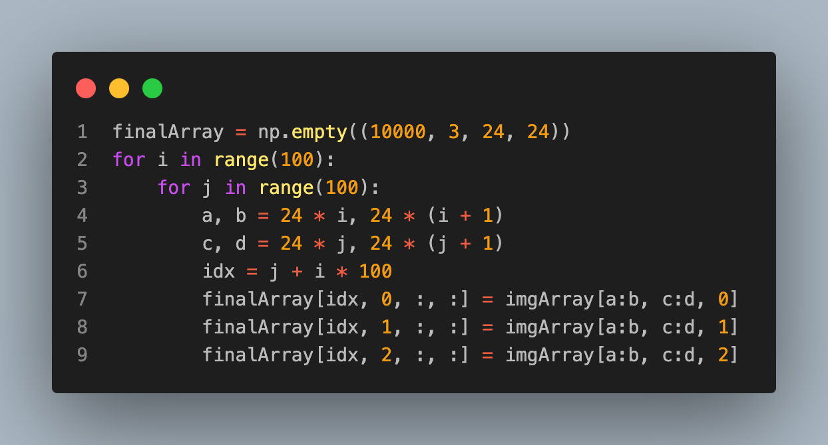
Formatting for PT

Slide 9
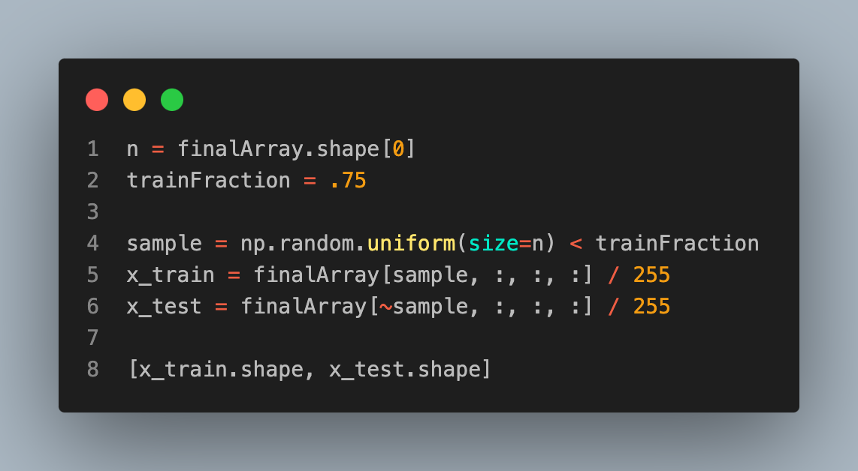
Normalization
[(7545, 3, 24, 24), (2455, 3, 24, 24)]

Slide 10
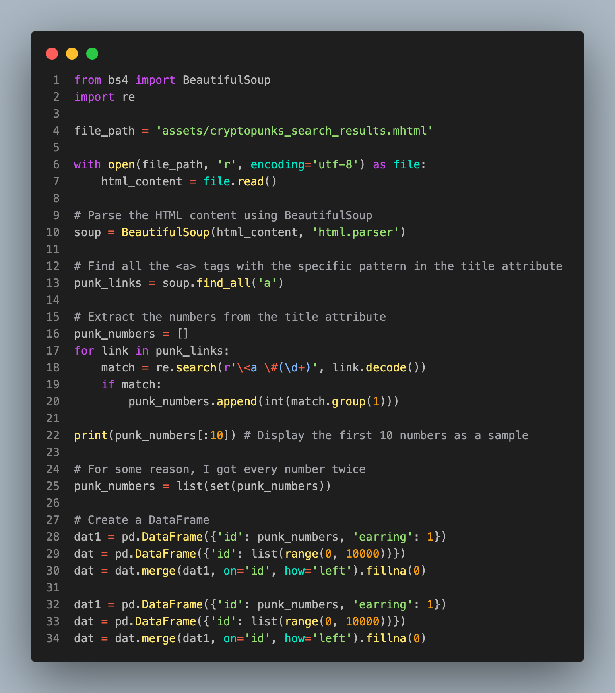
Getting earring status
[0, 4, 5, 16, 21, 23, 27, 29, 35, 45]

Slide 11
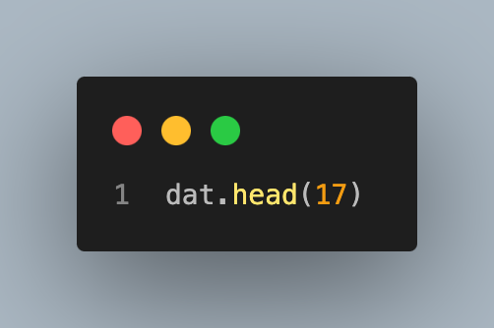
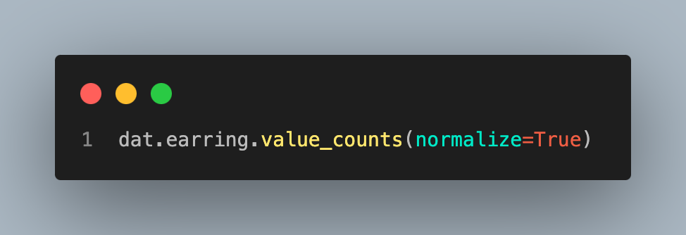
The result
 | id | earring
0 | 0 | 1.0
1 | 1 | 0.0
2 | 2 | 0.0
3 | 3 | 0.0
4 | 4 | 1.0
5 | 5 | 1.0
6 | 6 | 0.0
7 | 7 | 0.0
8 | 8 | 0.0
9 | 9 | 0.0
10 | 10 | 0.0
11 | 11 | 0.0
12 | 12 | 0.0
13 | 13 | 0.0
14 | 14 | 0.0
15 | 15 | 0.0
16 | 16 | 1.0
0.0 0.7541
1.0 0.2459
Name: earring, dtype: float64

Slide 12
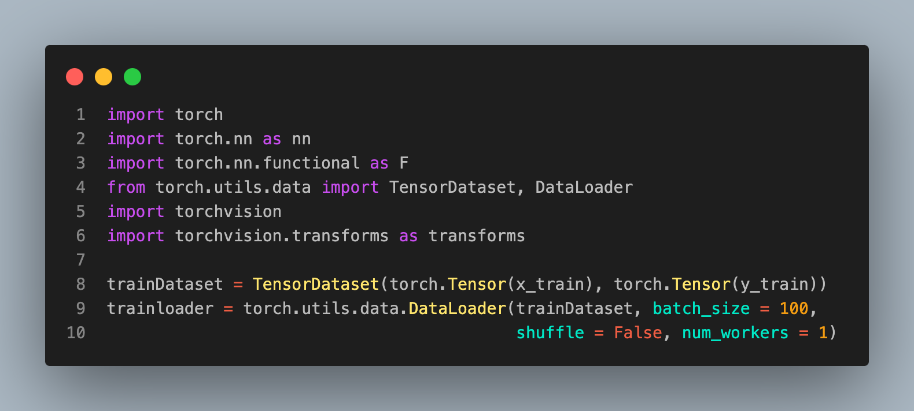
Setting up PT

Slide 13
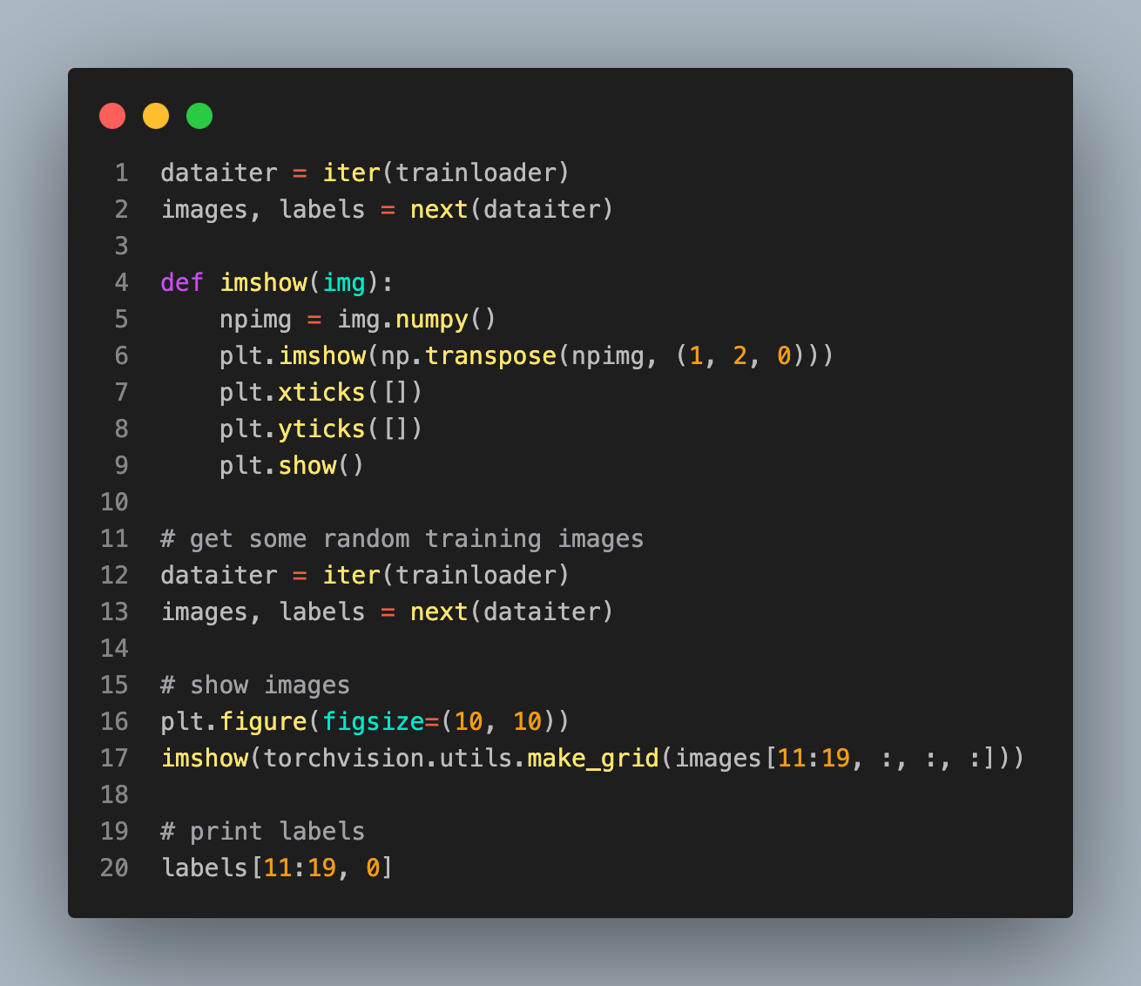
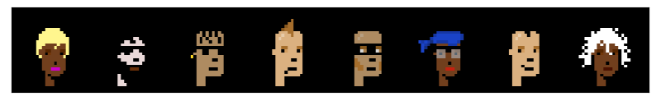
Checking our dataloader
tensor([0., 0., 1., 0., 0., 0., 0., 0.])

Slide 14
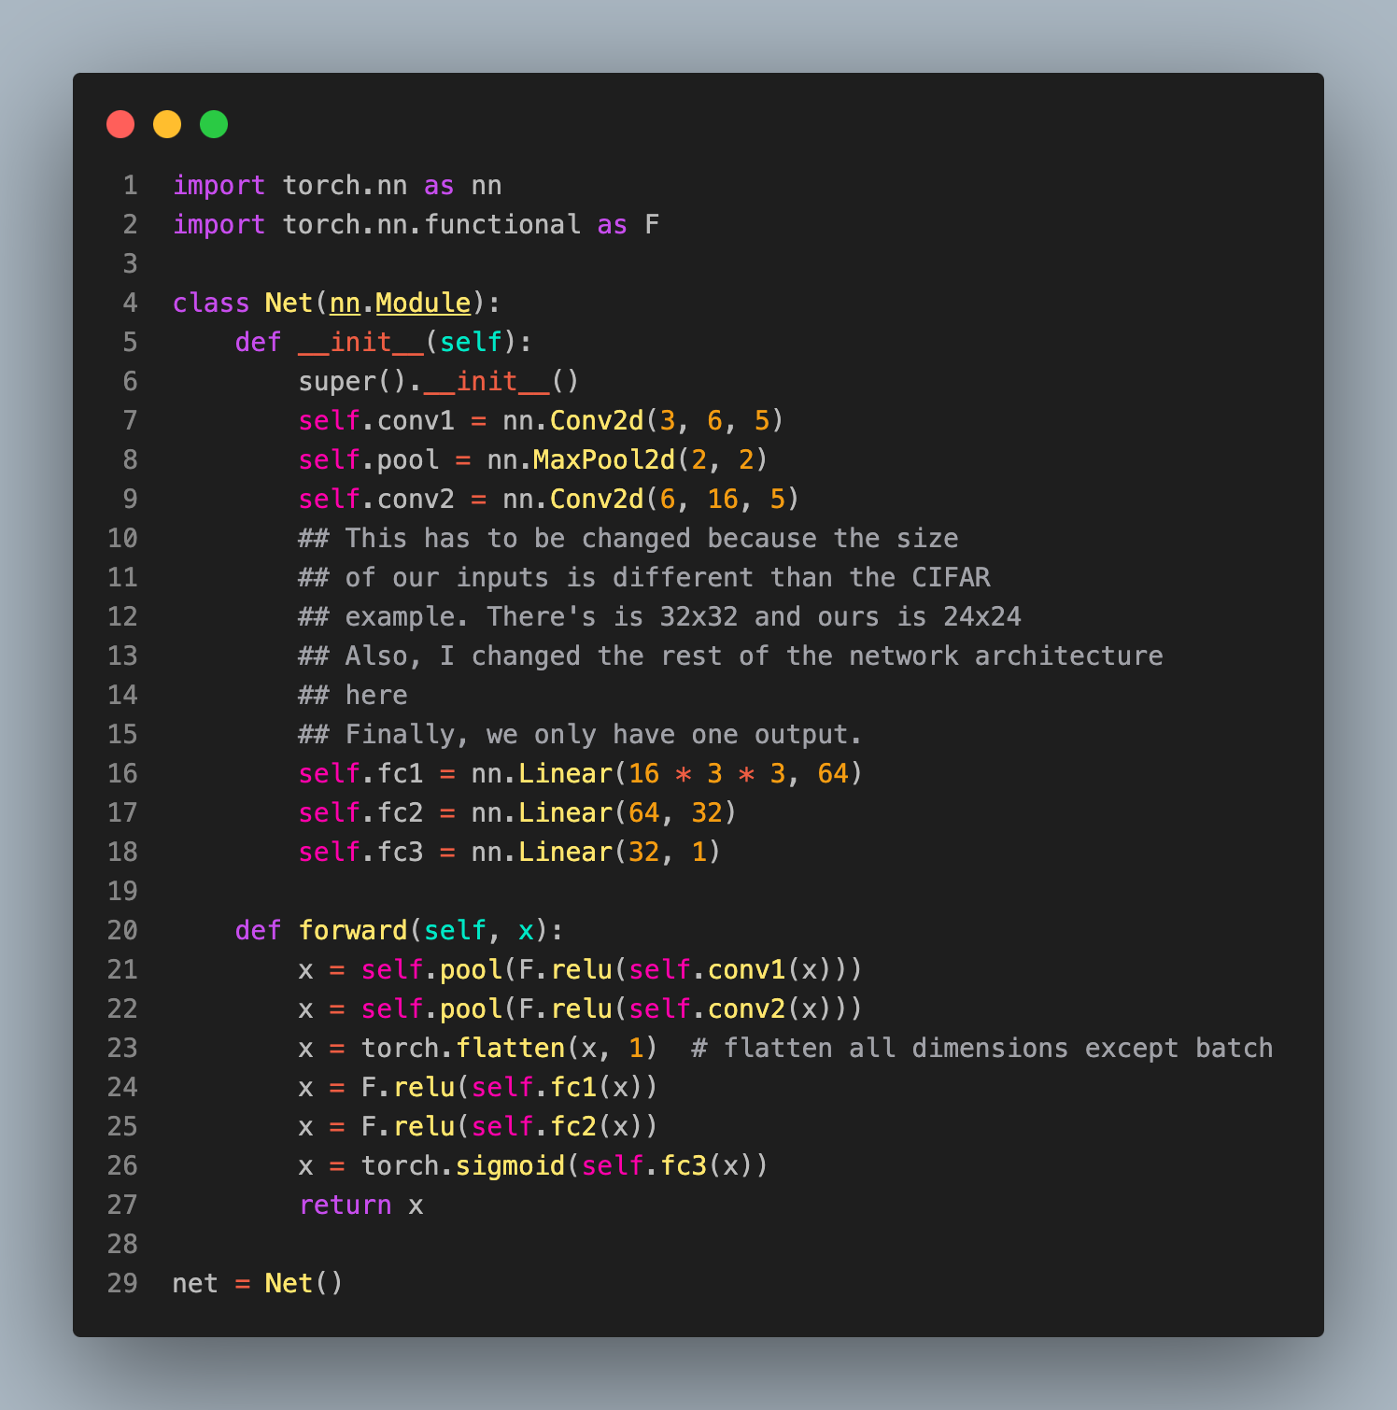
Setting up the NN

Slide 15
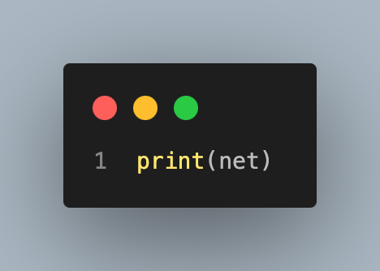
The model
Net(
(conv1): Conv2d(3, 6, kernel_size=(5, 5), stride=(1, 1))
(pool): MaxPool2d(kernel_size=2, stride=2, padding=0, dilation=1, ceil_mode=False)
(conv2): Conv2d(6, 16, kernel_size=(5, 5), stride=(1, 1))
(fc1): Linear(in_features=144, out_features=64, bias=True)
(fc2): Linear(in_features=64, out_features=32, bias=True)
(fc3): Linear(in_features=32, out_features=1, bias=True)
)

Slide 16
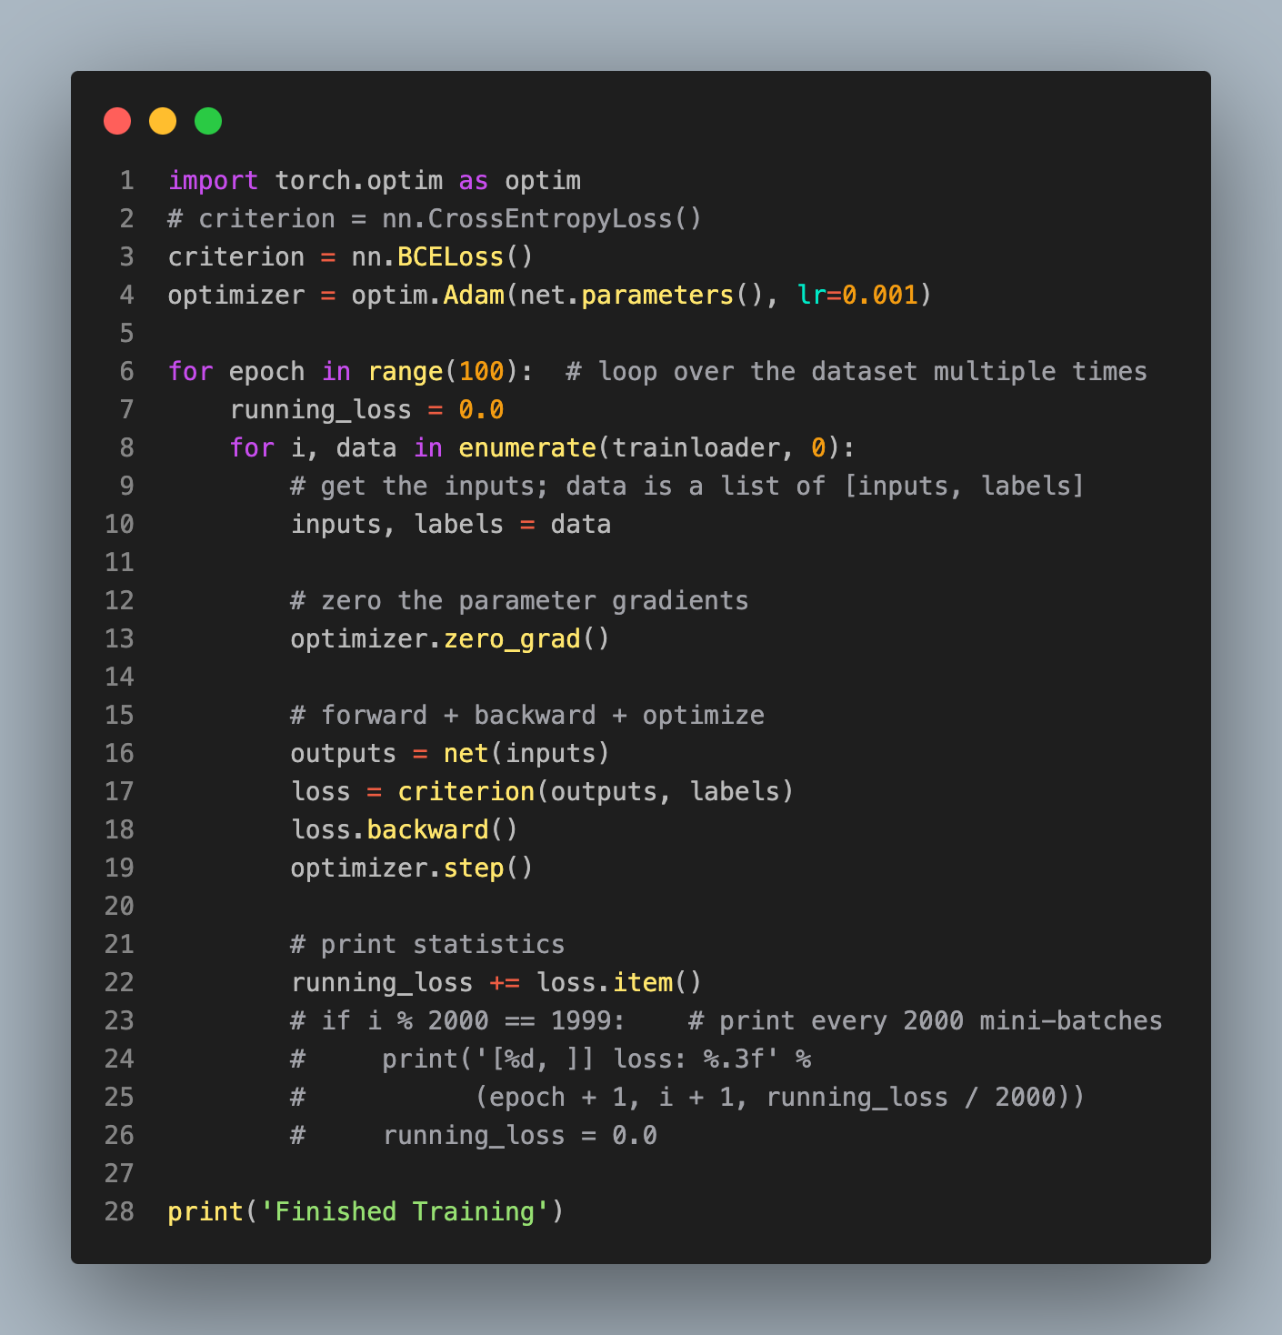
Training the model

Slide 17
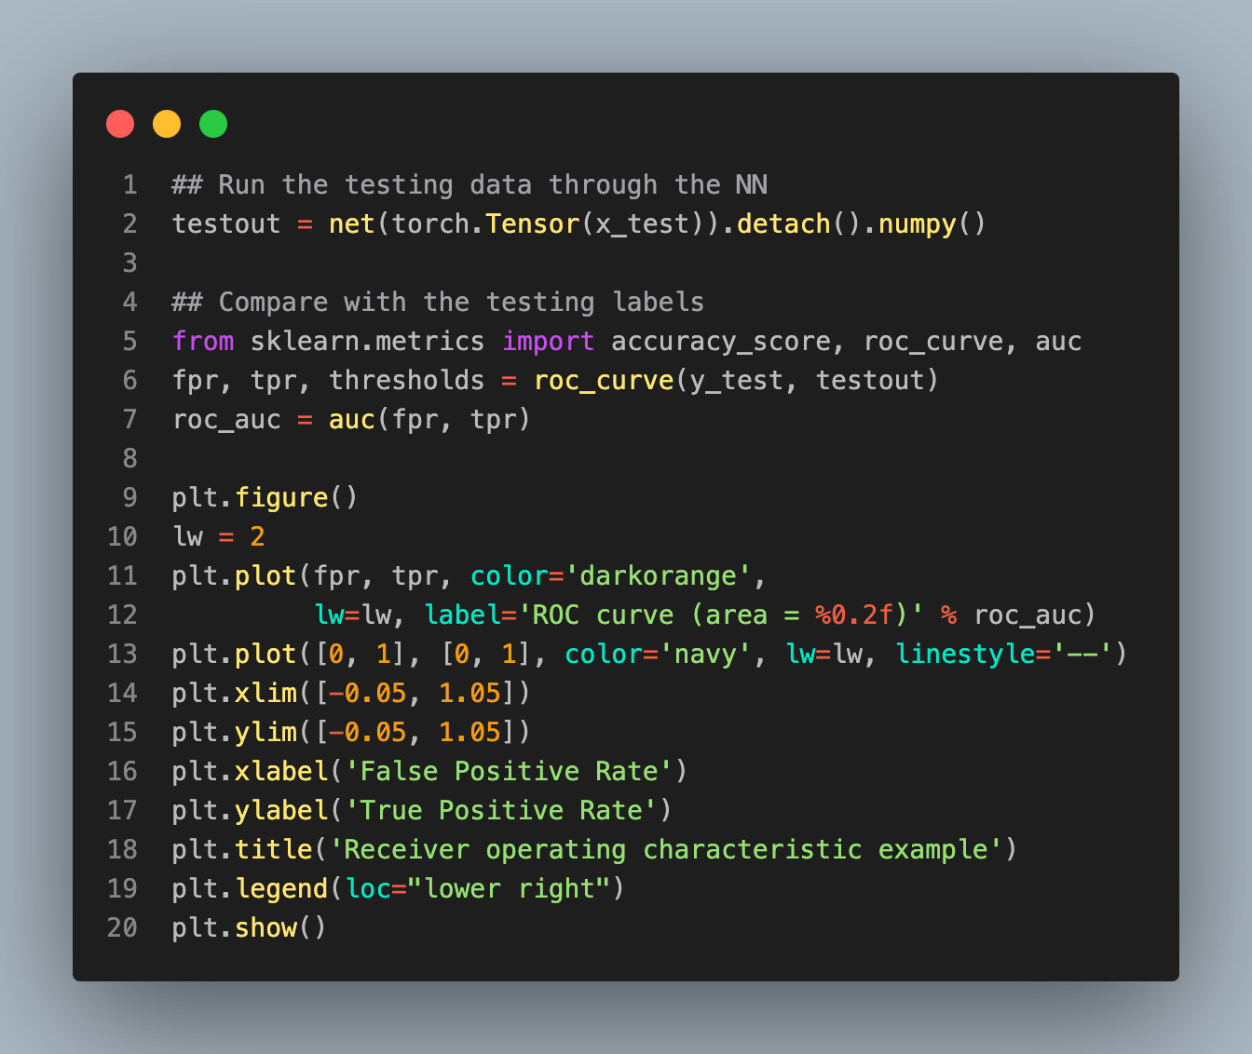
ROC curve

Slide 18
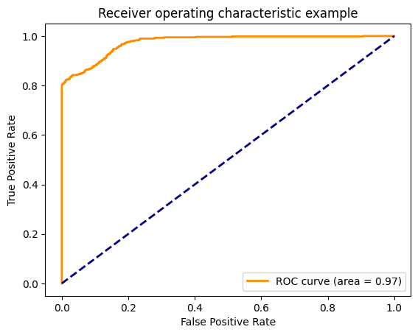
Performance

